Slide 1
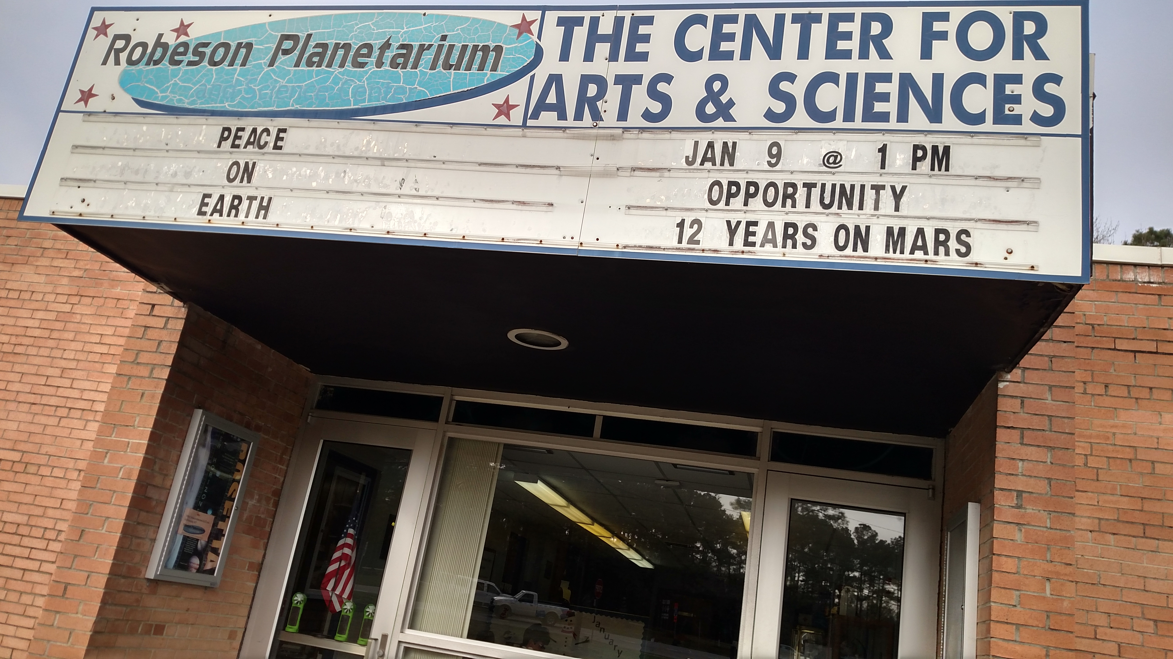
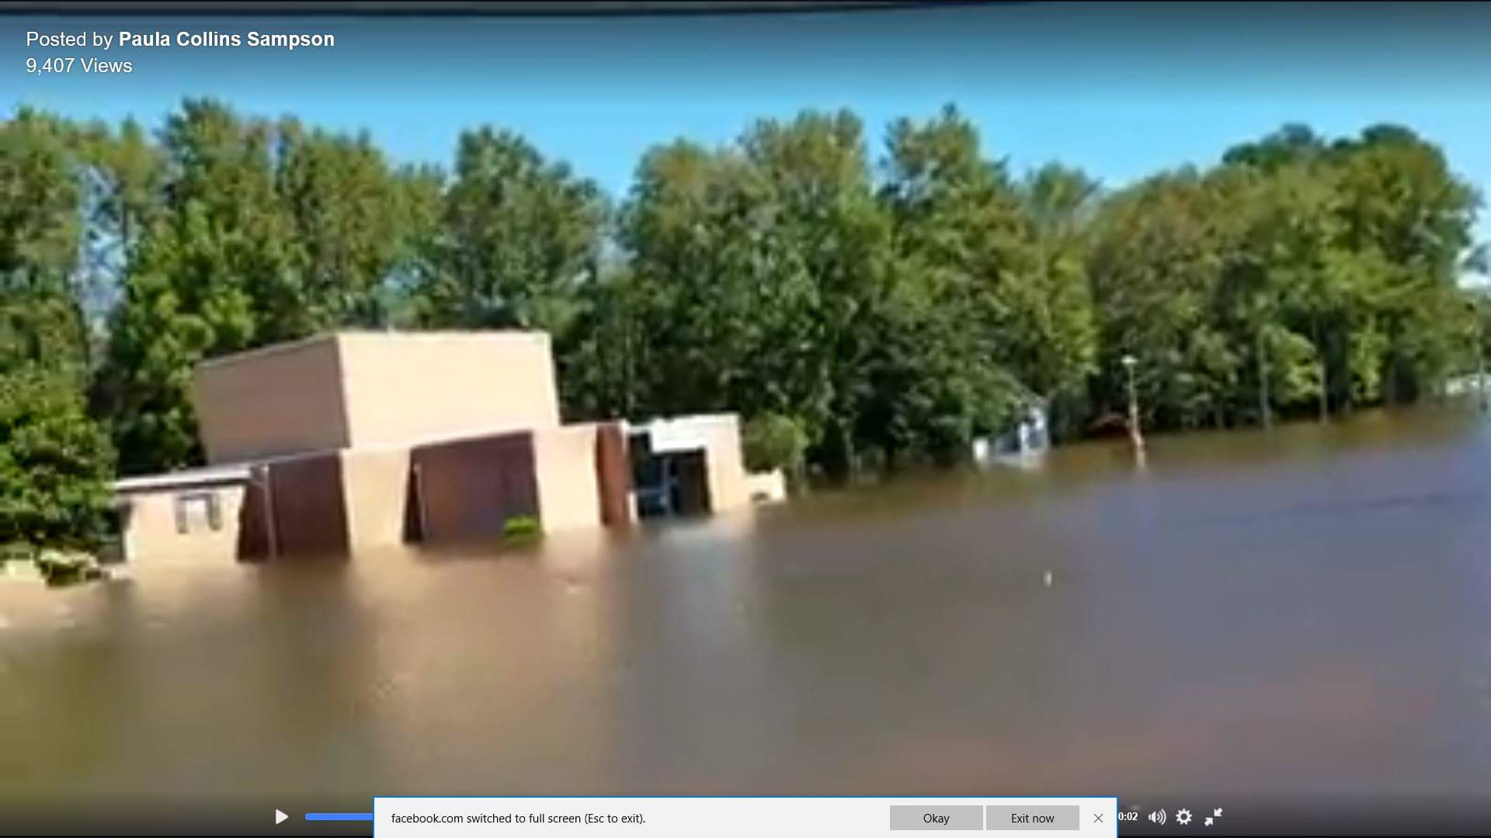
Presented by Ken Brandt
Past President, SouthEastern Planetarium Association;
Director, Robeson Planetarium and Science Center
JPL/NASA Solar System Ambassador/Master Teacher

Slide 2
Field Museum’s Day of Facts Video
Field Museum Youtube

Slide 3
Do you know where your local planetarium is?
The worldwide planetarium directory, published by the International Planetarium Society:
http://www.ips-planetarium.org/?page=dir
Or, The dulldome compendium, published by Lochness Productions (Peterson)
https://www.lochnessproductions.com/lfco/lfco.html

Slide 4
Planetarium room: know what the planetarium can do
Content in many areas of science, humanities, etc.
Usually has a “night sky” component
Ask and answer questions about current events in
space science

Slide 5
Do they have content that is standards related? In my planetarium: - misconceptions are addressed using modeling, kinesthetic astronomy, etc. - pre and post activities for teachers - all programs are standard-aligned (both state/national science standards, and Common Core)

Slide 6
Common Core and NGSS Venn diagram, courtesy Tina Chuek, Stanford

Slide 7
NC Science…Third Grade Standard: 3.E.1.1 Recognize that the earth is part of a system called the solar system that includes the sun (a star), planets, and many moons and the earth is the third planet from the sun in our solar system. …Sixth Grade Science Standards: 6.E.1.2 Explain why Earth sustains life while other planets do not based on their properties (including types of surface, atmosphere and gravitational force) and location to the Sun 6.E.1.3 Summarize space exploration and the understandings gained from them. …Seventh Grade Standard: 7.P.1.1 Explain how the motion of an object can be described by its position, direction of motion, and speed with respect to some other object.

Slide 8
Know the policies, rules, etc. before you arrive, and ENFORCE them. Examples: no entry after program begins No re-entry after it starts No electronic devices

Slide 9
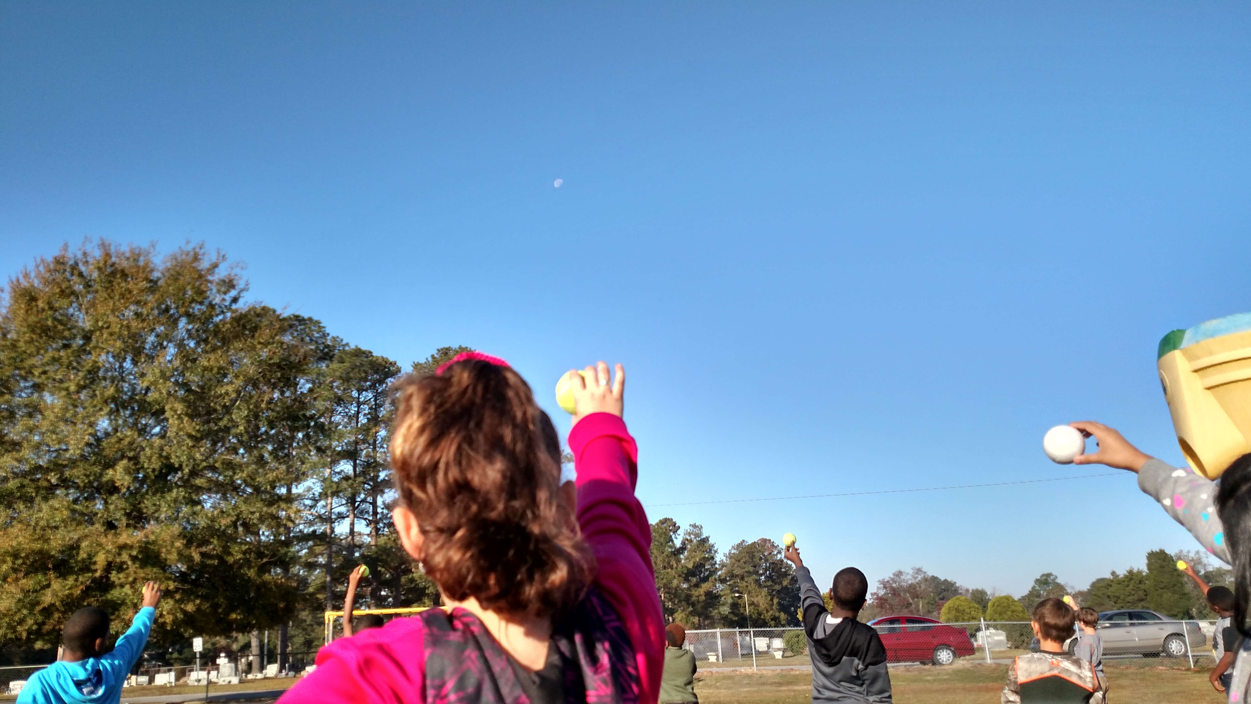
Do they outreach: can they come to you?
Kinesthetic modelling of
moon phases
Portable dome air drying after the flood: not salvageable ☹

Slide 10
Planetarium outreach examples:
Robeson Planetarium and Sci Ctr:
http://www.robeson.k12.nc.us/Page/49483
Morehead Planetarium:
http://moreheadplanetarium.org/outreach/educator-resources
Fernbank Science Center:
http://www.fernbank.edu/schoolgroups.htm

Slide 11
Outreach networks: JPL/NASA
Telecons, biweekly
Network with other pros & amateurs
Materials for display and distribution to public and educators
Application process: yearly (Sept.)
Email ambassad@jpl.nasa.gov
For more info

Slide 12
Outreach networks: Night Sky Network
Network of 100’s of amateur astronomy clubs
Good source for volunteers at events
Excellent way to network with local astro clubs
https://nightsky.jpl.nasa.gov/

Slide 13
Outreach networks: JPL/NASA Museum Alliance
Formed in 2003, to accompany launch of the two MER
Network of over 400 science centers, museums, and planetaria nationwide
To add your institution, email jeffrey.nee@jpl.nasa.gov

Slide 14
Outreach networks: SEPA and IPS
SouthEastern Planetarium Association
Over 100 planetaria in the Southeastern US
Quarterly Journal always looking for articles and other material www.sepadomes.org
International Planetarium Society
Hundreds of planetaria, international
Quarterly journal, more scholarly in nature than SEPA’s
www.ips.org

